Slide 1
US Gross Domestic Product Analysis
Elijah Taber | Caleb Trimble | Michael Speer
DSC450 - Applied Data Science
Professor Fadi Alsaleem

Slide 2
Introduction
Gross Domestic Product:
Per the Bureau of Economic Analysis, GDP is a comprehensive measure of U.S. economic activity. GDP measures the value of the final goods and services produced in the United States. Changes in GDP are the most popular indicator of the nation's overall economic health.
GDP is an excellent bellwether for when to invest and expand, or divest and withdraw.

Slide 3
The Investment Challenge
Traditional investment strategies rely heavily on historical performance and subjective market insights, which often fail to capture emerging macroeconomic trends and industry shifts.
Without reliable economic forecasting models, investors face unnecessary risks including capital allocation to declining industries and increased portfolio volatility.
The absence of data-driven investment frameworks leads to speculation-based decisions that consistently underperform compared to systematic approaches.

Slide 4

Data Sources
GDP by industry, wages and salaries by industry.
Total GDP by state and region.
Our analysis uses 20 years of quarterly U.S. GDP data from the Bureau of Economic Analysis, covering 83 distinct industries from all 50 states from 2005 to 2024.

Slide 5
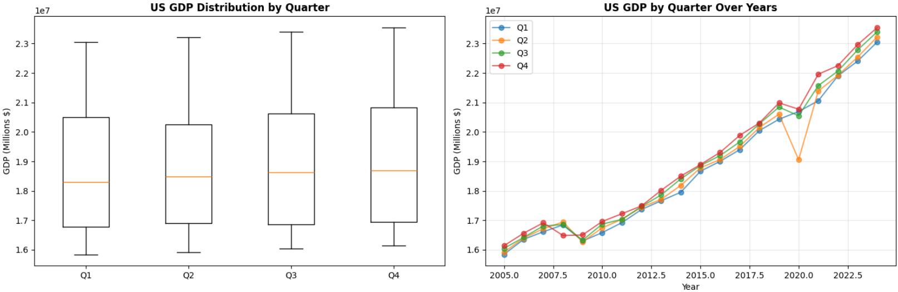
Economic Growth Overview
U.S. GDP has demonstrated consistent upward growth trajectory from 2005-2023, with quarterly distributions remaining remarkably stable across all four quarters.
Economic recovery patterns following major shocks like the 2008 financial crisis and 2020 pandemic provide valuable insights for predicting future resilience.

Slide 6
Methodology Overview
We employed multiple forecasting approaches, including ARIMA models for capturing long-term trends and cyclical patterns, and Linear Regression for aggregate growth analysis.
Industry-level predictions used MultiOutput Regression techniques alongside individual ARIMA models to account for sector-specific characteristics and dependencies.
Our validation methodology included walk-forward testing and Mean Absolute Percentage Error calculations to ensure model reliability and predictive accuracy.

Slide 7
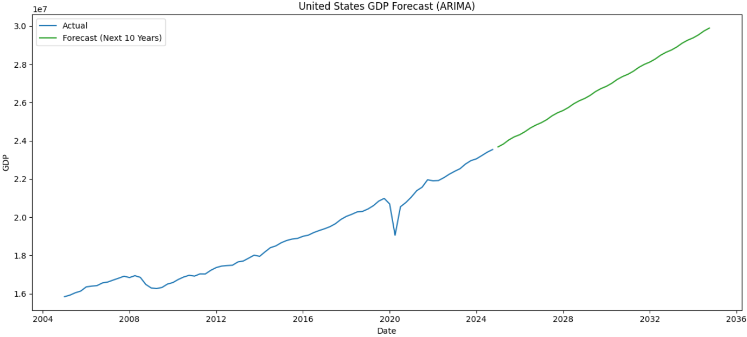
10-Year U.S. GDP Forecast
Our forecasting models successfully account for economic anomalies like the 2020 downturn, providing more nuanced predictions than traditional high-bias, low-variance architectures.
The ARIMA model projects sustained U.S. economic expansion through 2035

Slide 8
Industry GDP Forecasting Insights
The MultiOutput Regressor projects significant contractions in major sectors including Real Estate (from $3.91T to $2.81T) and Manufacturing (from $2.88T to $2.22T).
In contrast, individual ARIMA models forecast a more optimistic outlook with an average industry growth rate of 20.1% and expansion expected in 74 out of 83 industries.
This divergence between modeling approaches shows the inherent uncertainty in economic forecasting and reinforces the importance of diversified investment strategies.

Slide 9
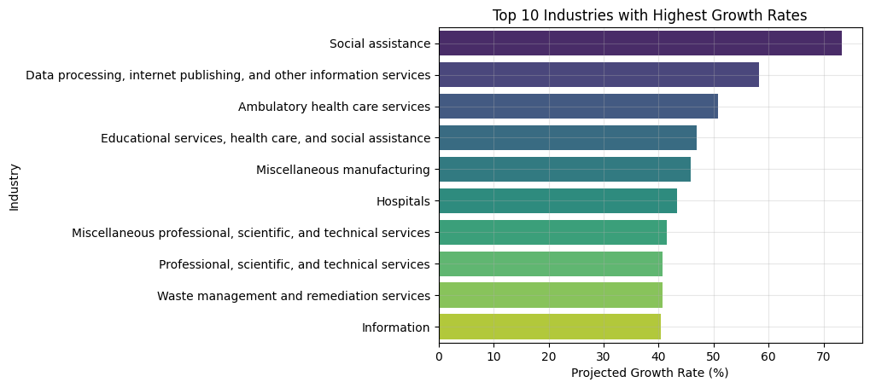
Investment Categories by Projected Growth Rate

Slide 10
High-Growth Investment Opportunities
Social Assistance leads growth projections at 73.3%, driven by demographic shifts toward an aging population and increased demand for support services.
Data Processing & Internet Services shows 58.2% projected growth, reflecting continued digital transformation and technology adoption across all economic sectors.
Ambulatory Health Care demonstrates 50.8% growth potential, combining the stability of essential services with expanding technological capabilities and service delivery models.

Slide 11
Investment Strategy Framework
Optimal portfolio allocation should balance 30-40% in high-growth emerging sectors like Social Assistance, Data Processing, and Healthcare to capture substantial upside potential.
The remaining 60-70% should be allocated to stability sectors including Real Estate, Educational Services, and established Manufacturing to provide consistent returns and reduce overall volatility.
Risk management through diversification across both model predictions and industry sectors helps mitigate the uncertainty inherent in any single forecasting approach.

Slide 12
Industry Deep Dive - Healthcare Sector
Healthcare represents a unique convergence of high growth potential and economic stability, with multiple sub-sectors showing strong projected performance across our models.
Demographic trends including an aging population, increased health consciousness, and technological integration create sustained demand drivers that transcend economic cycles.
The sector's essential nature provides recession resistance while innovation opportunities in telemedicine, personalized medicine, and health technology offer significant growth potential.

Slide 13
Risk Assessment & Limitations
Our forecasting models are based on historical patterns from 2005-2024 and cannot account for unprecedented events, major policy changes, or technological disruptions that fall outside historical precedent.
Model divergence between MultiOutput and ARIMA approaches demonstrates the inherent uncertainty in economic forecasting and the importance of considering multiple analytical perspectives.
Risk mitigation strategies include regular forecast updates with new data, diversified investment approaches across sectors and time horizons, and continuous monitoring of model performance against actual outcomes.

Slide 14
Strategic Recommendations & Next Steps
Immediate portfolio reallocation should target 30-40% allocation to high-growth sectors including Healthcare, Technology, and Social Services while maintaining 60-70% in stability sectors.
Implement quarterly forecast model updates to capture new economic data and adjust investment allocations based on evolving trends and model performance validation.
Transform investment decision-making from speculation-based approaches to systematic, data-driven strategies that leverage quantitative economic forecasting for superior risk-adjusted returns.

Slide 15
Tools and Libraries
Python
matplotlib
seaborn
pandas
numpy
statsmodels
Sklearn
Jupyter Notebook

Slide 16
Data Sources
Key Variables
GDPbyIndustry:
Access Date: May 30, 2025
Regional:
Access Date: May 30, 2025
NIPA Table: T20200A
Access Date: May 30, 2025
All tables available at http://apps.bea.gov/api/data
Region
Industry
Year and Quarter

Slide 17
References
GDP (current US$) - United States. World Bank Open Data. (n.d.). https://data.worldbank.org/indicator/NY.GDP.MKTP.CD?locations=US
U.S. Bureau of Economic Analysis, "Value Added by Industry" (accessed Sunday, May 18, 2025).
U.S. Bureau of Economic Analysis, "Table 6.3A. Wages and Salaries by Industry" (accessed Sunday, May 18, 2025).

